Slide 1
Data Structure & Algorithm
Binary Search Tree(BST)
AVL Tree

Slide 2
Binary Search Tree (BST)
Binary Search Tree, is a binary tree data structure which has the following properties:
The left subtree of a node contains only nodes with values lesser than the node’s value.
The right subtree of a node contains only nodes with value greater than the node’s value.
The left and right subtree each must also be a binary search tree.
There must be no duplicate nodes.

Slide 3
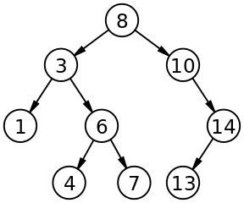
Example of BST

Slide 4
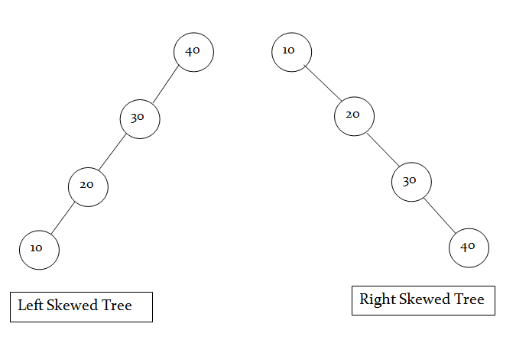
Skewed BST
If a tree which is dominated by left child node or right child node, is said to be a Skewed Binary Tree.
In a left skewed tree, most of the nodes have the left child without corresponding right child.
In a right skewed tree, most of the nodes have the right child without corresponding left child.

Slide 5
Limitation of BST
The average search time for a binary search tree is directly proportional to its height: O(h). Most of the operation average case time is O(log₂n).
BST’s are not guaranteed to be balanced. It may be skewed tree also.
For skewed BST, the average search time becomes O(n). So, it is working like an linear array.
To improve average search time and make BST balanced, AVL trees are used.

Slide 6
AVL Tree
AVL tree is a height balanced tree.
It is a self-balancing binary search tree.
It was invented by Adelson-Velskii and Landis.
AVL trees have a faster retrieval.
It takes O(logn) time for insertion and deletion operation.
In AVL tree, difference between heights of left and right subtree cannot be more than one for all nodes.

Slide 7
AVL Tree
Balance Factor of node is:
Height of left subtree – Height of Right subtree
Balance Factor is calculated for every node of AVL tree.
At every node, height of left and right subtree can differ by no more than 1.
For AVL tree, the possible values of balance factor are -1, 0, 1
Balance Factor of leaf nodes is 0 (zero).

Slide 8
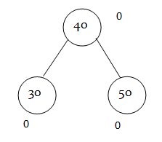
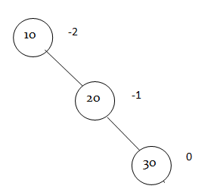
Example
Every AVL Tree is a binary search tree but all the Binary Search Tree need not to be AVL trees.
BST and AVL
BST but not AVL

Slide 9
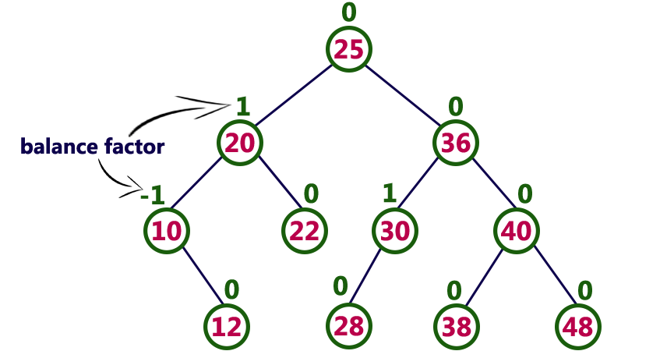
Finding Balance Factor
BF= h_{l} - h_{r}

Slide 10
Height of AVL Tree
By the definition of complete trees, any complete binary search tree is an AVL tree
Thus, an upper bound on the number of nodes in an AVL tree of height h a perfect binary tree with 2^{h + 1} – 1 nodes.
What is a lower bound?

Slide 11
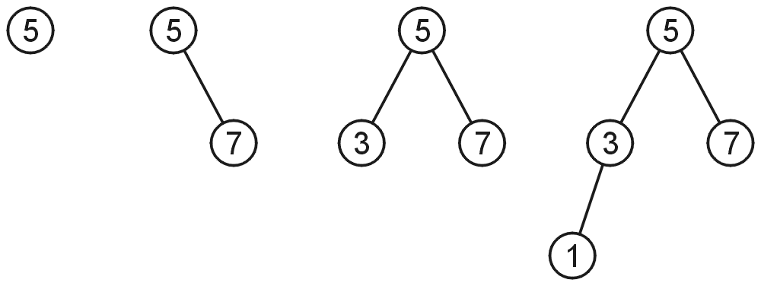
Height of AVL Tree
Let F(h) be the fewest number of nodes in a tree of height h.
From a previous slide:
F(0) = 1
F(1) = 2
F(2) = 4
Then what is F(h) in general?

Slide 12
Height of AVL Tree
The worst-case AVL tree of height h would have:
A worst-case AVL tree of height h – 1 on one side,
A worst-case AVL tree of height h – 2 on the other, and
The root node
This is a recurrence relation:
We get: F(h) = F(h – 1) + F(h – 2) + 1

Slide 13
Imbalance
After an insertion, when the balance factor of node A is –2 or 2, the node A is one of the following four imbalance types
LL: new node is in the left subtree of the left subtree of A
LR: new node is in the right subtree of the left subtree of A
RR: new node is in the right subtree of the right subtree of A
RL: new node is in the left subtree of the right subtree of A

Slide 14
AVL Tree Example
Insert 14, 17, 11, 7, 53, 4, 13 into an empty AVL tree
14
14
11
17
7
17
7
53
4
11
53
4
13

Slide 15
Types of Rotation
Rotation- To switch children and parents among two or three adjacent nodes to restore balance of a tree.
Rotation
Single Rotation
LL Rotation
RR Rotation
Double Rotation
LR Rotation
RL Rotation

Slide 16
Types of Rotation
Single Rotation is applied when imbalanced node and child has same sign of BF (in the direction of new inserted node).
LL Rotation is applied in case of +ve sign. It mean left tree is heavy and so LL rotation is done.
RR Rotation is applied in case of -ve sign. It mean right tree is heavy and so RR rotation is done.
Double Rotation is applied when imbalanced node and child has different signs of BF (in the direction of new inserted node).

Slide 17
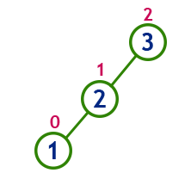
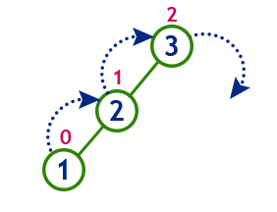
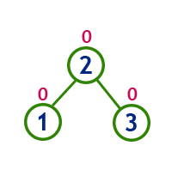
LL Rotation
Insert 3,2,1 in AVL Tree
L
L
Imbalanced AVL Tree
LL Rotation
Balanced AVL Tree

Slide 18
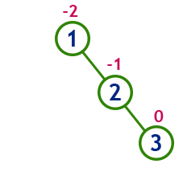
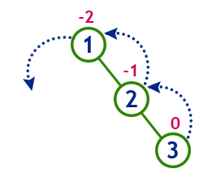
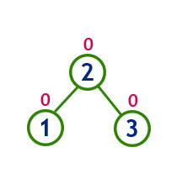
RR Rotation
Insert 1,2,3 in AVL Tree
R
R
Imbalanced AVL Tree
RR Rotation
Balanced AVL Tree

Slide 19
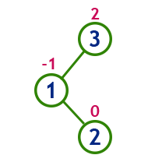
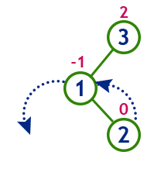
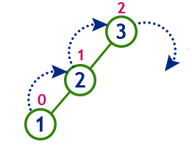
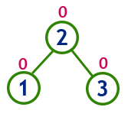
LR Rotation
Insert 3, 1, 2 in AVL Tree
L
R
Imbalanced AVL Tree
RR Rotation
LL Rotation
Balanced AVL Tree

Slide 20
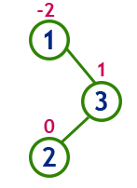
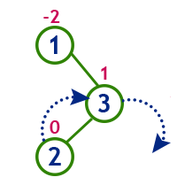
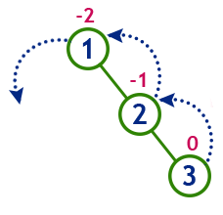
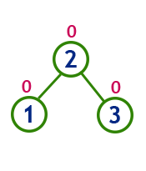
RL Rotation
Insert 1, 3, 2 in AVL Tree
R
L
Imbalanced AVL Tree
LL Rotation
RR Rotation
Balanced AVL Tree

Slide 21
Construct a AVL Tree by inserting from 1 to 5 numbers
1
-1
1
-2
1
0
2
3
2
2
-1
0
3
0
Not AVL
Apply RR Rotation

Slide 22
Construct a AVL Tree by inserting from 1 to 5 numbers
2
0
2
-1
2
-2
4
5
0
1
3
-1
1
3
-2
0
1
3
0
0
4
0
4
-1
After Rotation
5
0

Slide 23
Construct a AVL Tree by inserting from 1 to 5 numbers
2
-1
1
4
0
0
3
5
0
0
AVL Tree

Slide 24
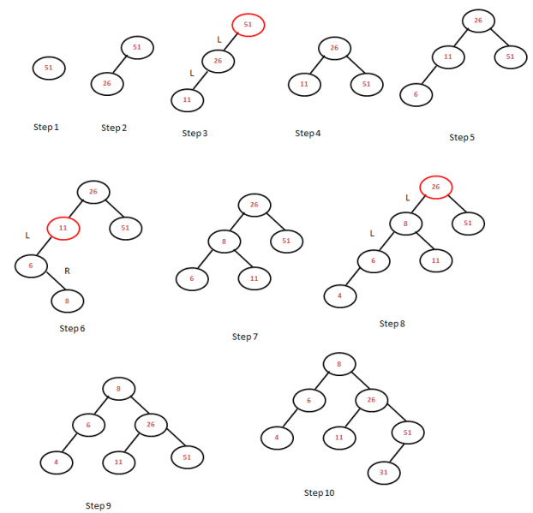
Construct AVL Tree with data items: 51, 26, 11, 6, 8, 4, 31

Slide 25
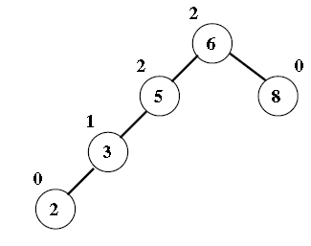
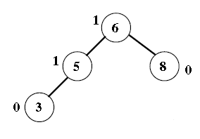
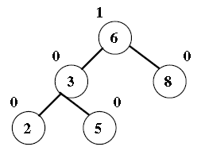
Insertion in AVL Tree
Insert 2
LL Rotation

Slide 26
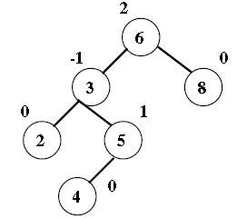
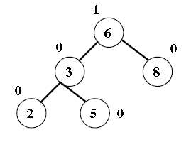
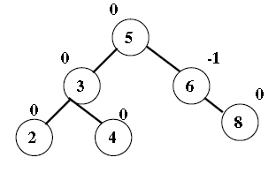
Insertion in AVL Tree
Insert 4
LR Rotation
(3, 5, 6)

Slide 27
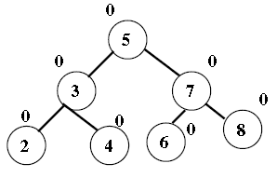
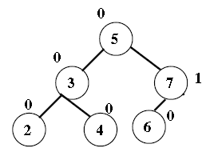
Deletion in AVL Tree
It is also possible to delete an item from AVL Tree.
Delete 8
Balanced AVL
Balanced AVL

Slide 28
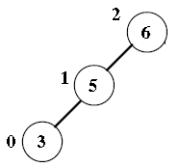
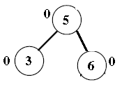
Deletion in AVL Tree
Just like insertion, deletion can cause an imbalance, which will need to be fixed by applying one of the four rotations.
Delete 8
R1 Rotation
Balanced AVL
Imbalanced AVL

Slide 29
Deletion in AVL Tree
The deletion is also the same as in BST. However, in imbalanced tree due to deletion, one or more rotations need to be applied to balance the AVL tree.
The Right(R) imbalance is classified into R0, R1, R-1
The Left(L) imbalance is classified into L0, L1, L-1

Slide 30
Deletion in AVL Tree
LL Rotation is same to R0 and R1
RR Rotation is same to L0 and L-1
LR Rotation is same to R-1
RL Rotation is same to L1

Slide 31
R0 Rotation
(+1)
A
(+2)
A
Delete node X
(0)
B
(0)
B
A_{R}
A_{R}
h
x
h
h
h -1
B_{L} B_{R}
B_{L} B_{R}
Unbalanced AVL
search tree after deletion of node x

Slide 32
R0 Rotation
(+2)
A
(-1) B
(+1)
A
(0)
B
R0 Rotation
A_{R}
B
L
h
h
A
BF(B) == 0, use
R0 rotation
R
B
B_{L} B_{R}
Unbalanced AVL search tree after deletion of x
R
Balanced AVL search tree after rotation

Slide 33
R0 Rotation Example
(+1)
(+2)
46
46
(-1)
Delete 60
(0)
54
(-1)
(0)
(0)
20
54
20
(+1)
18
(0)
₂₃ (-1) ₆₀
(0) ²⁴
(+1)
18 23
(0)
7
(0) ²⁴
(0)
7
Unbalanced AVL search tree after deletion

Slide 34
R0 Rotation Example
(+2)
(-1)
20
46
(0)
54
(0)
(+1)
46
(0)
54
R0
(+1)
20
18
(+1)
18
₂₃ (-1)
(0) ²⁴
(0)
7
(-1)
23
(0)
7
(0) ²⁴
Balanced AVL search tree
after deletion

Slide 35
R1 Rotation
(+1)
A
(+2)
A
(+1) B
Delete node X
(+1) B
_{h} A_{R}
h -1 _{AR}
h
B_{L} B_{R}
x
h
B_{L} B_{R}
h -1
h -1
Unbalanced AVL search tree after deletion of node x

Slide 36
R1 Rotation
(+2)
A
(0)
B
(0)
A
(+1) B
R1 Rotation
h -1 ^{A}R
B
L
h-1 _{A}
h
h -1
BF(B) == 1, use
R1 rotation
R
B
B_{L} B_{R}
R
Balanced AVL search tree after rotation

Slide 37
R1 Rotation Example
(+1)
(+2)
37
37
(+1)
26
(+1)
Delete 39
(0)
41
(0)
(+1)
41
26
(+1)
18
₂₈ 39 (0)
(0)
(+1)
18 28
(0) ₁₆
(0) ₁₆
Unbalanced AVL search tree after deletion

Slide 38
R1 Rotation Example
(+2)
(0)
26
37
(0)
41
(+1)
26
(0)
37
(+1)
R1 Rotation
(0)
18
(+1)
18
(0)
28 (0)
(0)
16 28
41
(0) ₁₆
Balanced AVL search tree
after deletion

Slide 39

R-1 Rotation
A (+1)
(+2)
A
(-1)
B
(-1)
B
(0)
Delete X
C
h-1
_{C} (0)
h
h-1
A_{R}
x
B_{L}
C_{R}
C
B_{L}
C_{L} C_{R} A_{R}
L
Unbalanced AVL search tree after deletion

Slide 40
R-1 Rotation
(+2)
A
(-1)
B
A (+2)
(+1)
C
h -1
R -1
(0)
_{C} (0)
B
h-1
C_{R}
A_{R}
BF(B) == -1,
B
C_{L}
B_{L}
C_{L} C_{R} A_{R}
use R-1 rotation
L

Slide 41
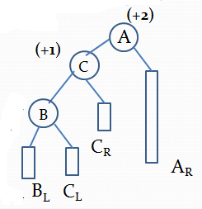
R-1 Rotation
(0)
C
(0)
B
h -1
(0)
A
h -1
R -1
(0)
C_{L}
B
C_{R}
L
A_{R}
Balanced AVL search tree after Rotation

Slide 42
R-1 Rotation Example
(+1)
44
(+2)
44
(0)
48
(-1)
22
⁽⁻¹⁾ Delete 52
48
(-1)
22
(0)
18
(0)
18
₂₈ (0)
29
52
₂₈ (0)
23
₂₃ (0)
29
Unbalanced AVL search
tree after deletion

Slide 43
R-1 Rotation Example
(+2)
44
(+2)
44
(0)
48
(-1)
22
⁽⁻¹⁾ R-1 Rotation
48
(+1)
28
(0)
18
(0)
22
₂₈ (0)
29
₂₉ (0)
(0)
18
23
₂₃ (0)
Unbalanced AVL search
tree after deletion

Slide 44
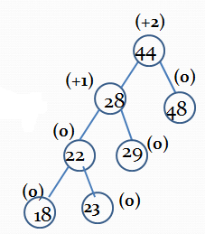
R-1 Rotation Example
(0)
28
(0)
44
(0)
22
(0)
(0) (0)
18 23 ₂₉
48
Balanced AVL search tree
after rotation

Slide 45
L0 Rotation
(-1)
A
(-2)
A
Delete X
_{B} (0)
_{B} (0)
h-1
h
A_{L}
h
h
x
A_{L}
B_{L} B_{R}
B
L
B_{R}
Unbalanced AVL search tree after deletion

Slide 46
L0 Rotation
(-2)
A
_{B} (0)
(+1)
B
L0 Rotation
(0)
h -1
(-1)
_{AL} A
h
h
B_{R}
h-1
A_{L}
B_{L} B_{R}
B_{L}
Balanced AVL search tree after deletion

Slide 47
L0 Rotation
⁽⁻¹⁾
⁽⁻²⁾
48
Delete 22
48
(1)
44
52
(0)
(0)
44
52
(0)
50
50
(0)
22
(1)
54
(-1)
(1)
54
(-1)
(0)
49
49
56
(0)
56
(0)
(0)

Slide 48
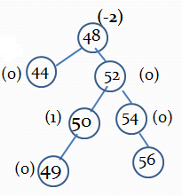
L0 Rotation
⁽¹⁾
52
L0 Rotation
48
⁽⁻¹⁾
54
(-1)
(0)
44
50
56
(0)
(1)
49
(0)

Slide 49
L1 Rotation
(-1)
A
(-2)
A
_{B} (+1)
Delete X
_{B} (+1)
h-1
h
(0)
C
A_{L}
(0)
C
h-1
x
A
h-1
B
L
B_{R}
R
h-1
C_{L} C_{R}
Unbalanced AVL
C
C_{R}
L
search tree after deletion

Slide 50
L1 Rotation
(-2)
A
(0)
C
_{B} (+1)
L1 Rotation
(0)
(0)
B
h-1
A
(0)
C
h-1
h-1
B
h-1
A
B_{R}
L
C_{R}
R
h-1
C
A
L
L
Unbalanced AVL search tree after deletion
C
C_{R}
L

Slide 51
L1 Rotation
⁽⁻¹⁾
48
⁽⁻²⁾
Delete 22
48
(1)
44
51
(1)
(0)
44
51
(1)
50
(-1)
50
22
52
(0)
(1)
52
(0)
(0)
49
(0)
49
(0)

Slide 52
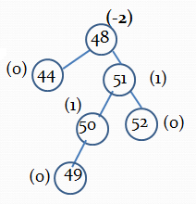
L1 Rotation
L1 Rotation
48
(-2)
(0)
50
(-1)
44
(0)
49
51
(-1)
52
(0)

Slide 53
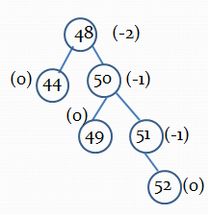
L1 Rotation
L1 Rotation
50
(0)
(0)
51
(-1)
48
44
49
52
(0)
(0)
(0)

Slide 54
L-1 Rotation
(-1)
A
(-2)
A
_{B} (-1)
Delete X
_{B} (-1)
h-1
h
h-1
A_{L}
h-1
h
h
x
A_{L}
B_{L} B_{R}
B
L
B_{R}
Unbalanced AVL search tree after deletion

Slide 55
L-1 Rotation
(-2)
A
(0)
B
_{B} (-1)
L-1 Rotation
(-1)
h-1
A
h-1
h
h
A_{L}
B_{L} B_{R}
h-1 _{BL}
A
B
L
R
Balanced AVL search tree after deletion

Slide 56
L-1 Rotation
(-1)
44
(-2)
44
(1)
22
⁽⁻¹⁾ Delete 18
48
(0)
22
⁽⁻¹⁾
48
(0)
18
(0)
(0)
47
52
52
(0)
50
(0)
47
54
(0)
50
(0)
54
(0)
(0)

Slide 57
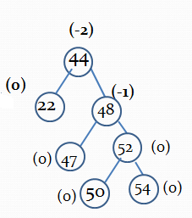
L-1 Rotation
⁽⁰⁾
48
L-1 Rotation
(0)
44
52
(0)
50
22
47
54
(0)
(0)
(0)

Slide 58
Summary
Binary Search Tree and its Limitation
AVL Tree
Definition
Rotation & its Types
Insertion
Deletion

